Slide 1
Figure 7.1

Slide 2
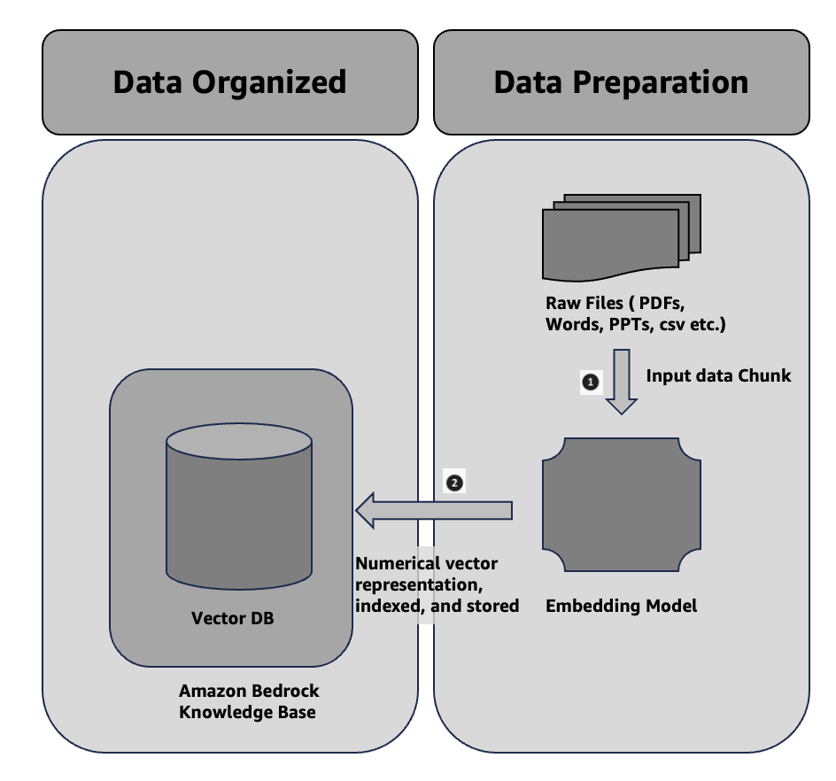

Slide 3
Figure 7.2

Slide 4
Experiences
Information Retrieval & Generation
Data Organized
Data Preparation
Query
Search relevant information
Prompt + Query
Raw Files ( PDFs, Words, PPTs, csv etc.)
Search operation
Input data Chunk
Enhanced Context
Gen AI App
Query + Enhanced Contexed
Relevant information
Numerical vector representation, indexed, and stored
Generated
Response
Vector DB
Embedding Model
Responses
Gen AI LLM Model
Amazon Bedrock Knowledge Base

Slide 5
Figure 7.3

Slide 6
RAG chunking divides
documents into smaller
parts. This helps improve
retrieval accuracy.
chunk 1
chunk 2
chunk 3
chunk 4

Slide 7
Figure 7.4

Slide 8
RAG chunking divides documents into smaller parts. This helps improve retrieval accuracy.
chunk 1

Slide 9
Figure 7.5

Slide 10
Newspaper
Sports News
Soccer world cup section
Wimbledon Championships
section
FINA World Championships
section
chunk 1
chunk 2
chunk n
Hierarchical 1
Political News
Political events
Speeches by leaders
Political critique and opinion
chunk 1
chunk 2
chunk n
Hierarchical 2

Slide 11
Figure 7.6

Slide 12
Both the sentences semantic with RAG related information.
RAG chunking divides documents into smaller parts. This helps improve retrieval accuracy.
chunk 1
All the sentences semantic with finetuning related information.
Fine-tuning generative AI models customizes them by using specific datasets. This enhances their relevance for niche tasks. It also allows for more accurate outputs by adapting pre-trained models to meet specialized needs.
chunk 2

Slide 13
Figure 7.7

Slide 14
semantic meaning with RAG related information and useful tag of the chunk.
{ Tag: genai, rag, chunking } ; RAG chunking divides documents into smaller parts. This helps improve retrieval accuracy.
chunk 1
semantic meaning with finetuning related information and useful tag of the chunk.
{ Tag: genai, rag, finetuning } ; Fine-tuning generative AI models customizes them by using specific datasets. This enhances their relevance for niche tasks. It also allows for more accurate outputs by adapting pre-trained models to meet specialized needs.
chunk 2

